Slide 1
Question : What is a quadrilateral?
Learning Intention: to identify different types of quadrilateral and describe their properties

Slide 2
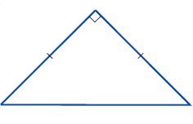
5 QUESTIONS
Find the missing angle size
2. Name this triangle according to its side lengths and also its angle size
3. A $400 raffle prize is split between 2 friends in a ratio of 3:5. How much does each friend get?
4. How far will I travel in 6 hours if I travel at 40km/hr
5. Complete your summary from last lesson. Is you contents and glossary up to date?
78º
xº

Slide 3
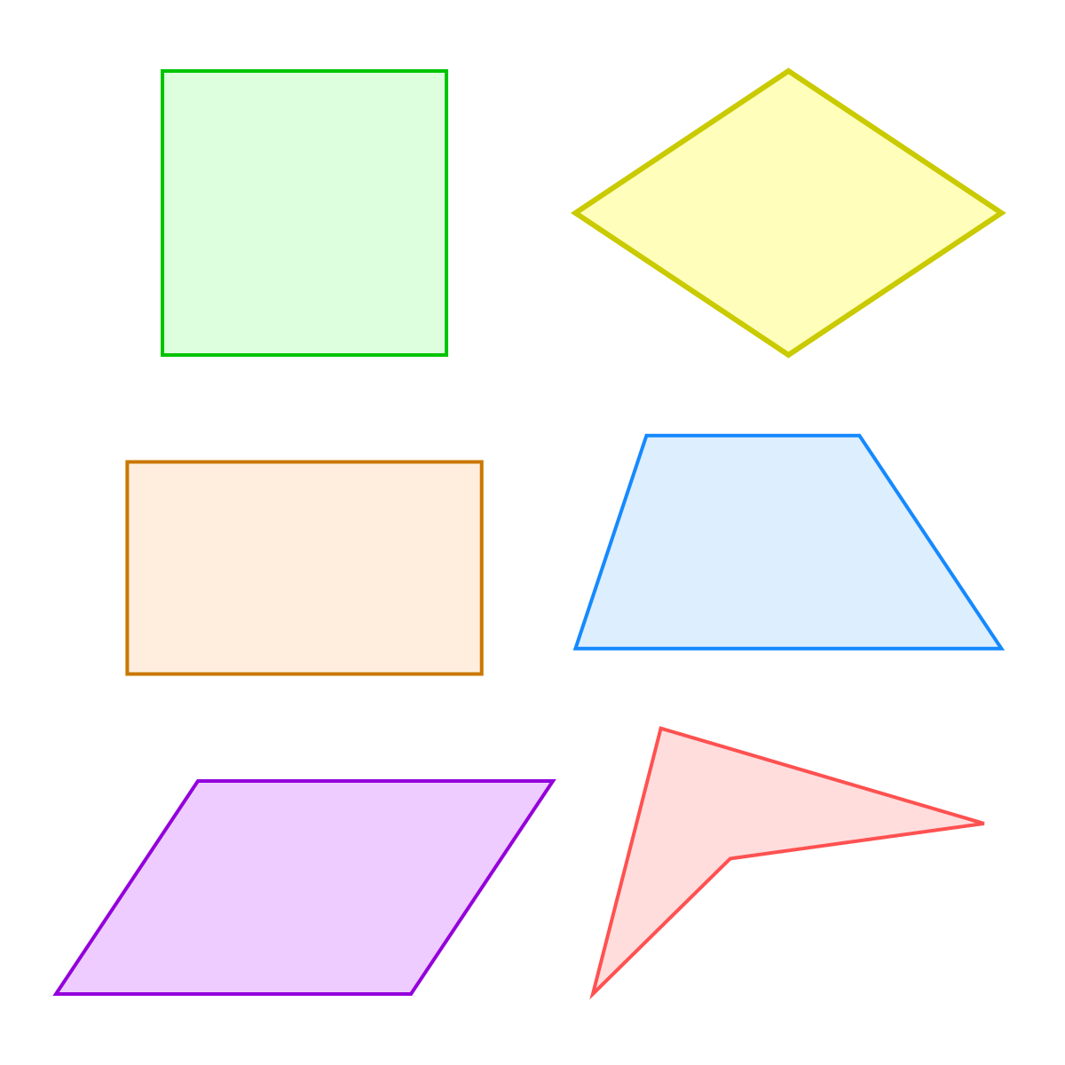
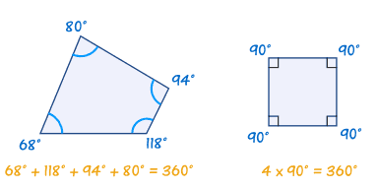
24
7
30
Topic: Quadrilaterals
Date:
EQ – How do we classify quadrilaterals?
What is a quadrilateral?
A quadrilateral has four sides and four angles
All the angles add up to 360°

Slide 4
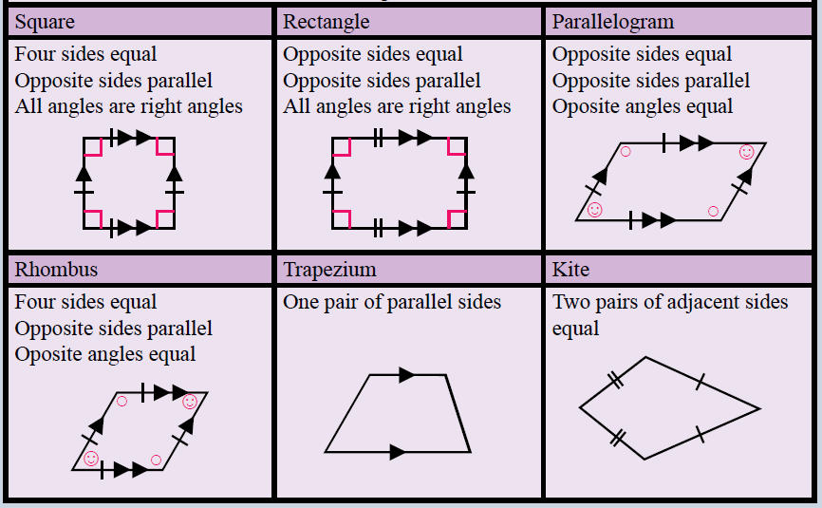
Notes:
Draw a table like the following in your book:

Slide 5
Rectangle
2 pairs of parallel sides
2 pairs of opposite sides equal in length
4 right angles
2 lines of symmetry

Slide 6
Rhombus
2 pairs of parallel sides
All 4 sides equal in length
Opposite angles are equal

Slide 7
Trapezium
1 pair of parallel sides

Slide 8
Square
2 pairs of parallel sides
All 4 sides equal in length
4 right angles
4 lines of symmetry

Slide 9
kite
2 pairs of adjacent sides equal in length
1 line of symmetry

Slide 10
Parallelogram
2 pairs of parallel sides
2 pairs of opposite sides equal in length
Opposite angles are equal

Slide 11
Investigation
Create a quadrilateral (any quadrilateral)
Measure the angles inside the quadrilateral.
Carefully tear off your quadrilateral’s 4 corners and arrange them, pointing in.
What do you notice?
See what others noticed.
What does this tell you about quadrilaterals?

Slide 12
Investigation part 2
Create a triangle (any triangle)
Measure the angles inside the triangle.
Carefully tear off your triangles’s 3 corners and arrange them, pointing in.
What do you notice?
See what others noticed.
What does this tell you about Triangles?

Slide 13
Learning Intention: to identify different types of quadrilateral and describe their properties
How well do you understand? How confident do you feel in your learning?

